Slide 1
Repetitious operations

Slide 2
Outline
In this presentation, we will:
Review conditional statements
Introduce repetitious operations
Review the game of PictionaryTM
Describe how these solve specific real-wold problems
Understand the need for true/false conditions to continue looping
Look at the flow chart

Slide 3
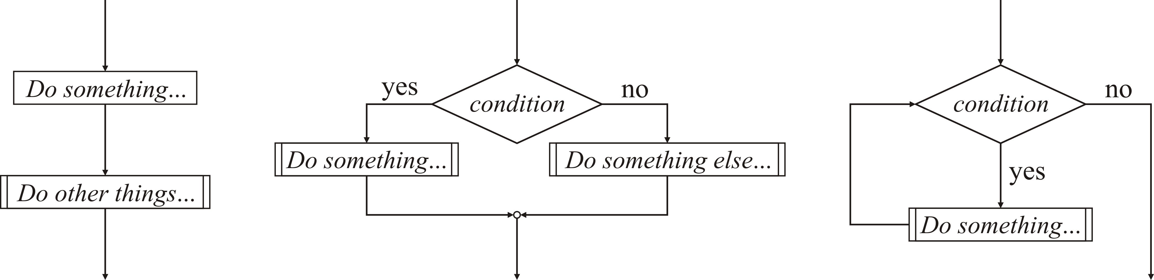
Conditional statements
In real-world situations, you take actions based on criteria or conditions
Programming languages restrict decisions to only those that are absolutely necessary to accomplish goals
This boils down to Boolean-valued conditional statements
if ( condition ) {
// Do something…
} else {
// Do something else…
}

Slide 4
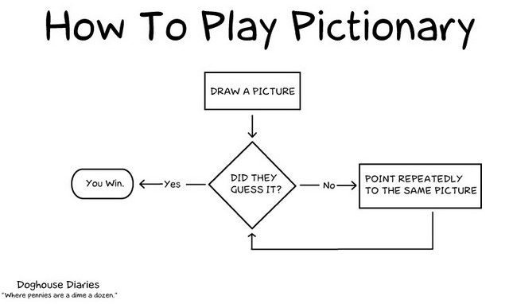
Repetitious operations
Another possibility is to repeat an operation until some goal is accomplished
In Pictionary, you are given a word and you must get the audience to guess the word based on a drawing

Slide 5
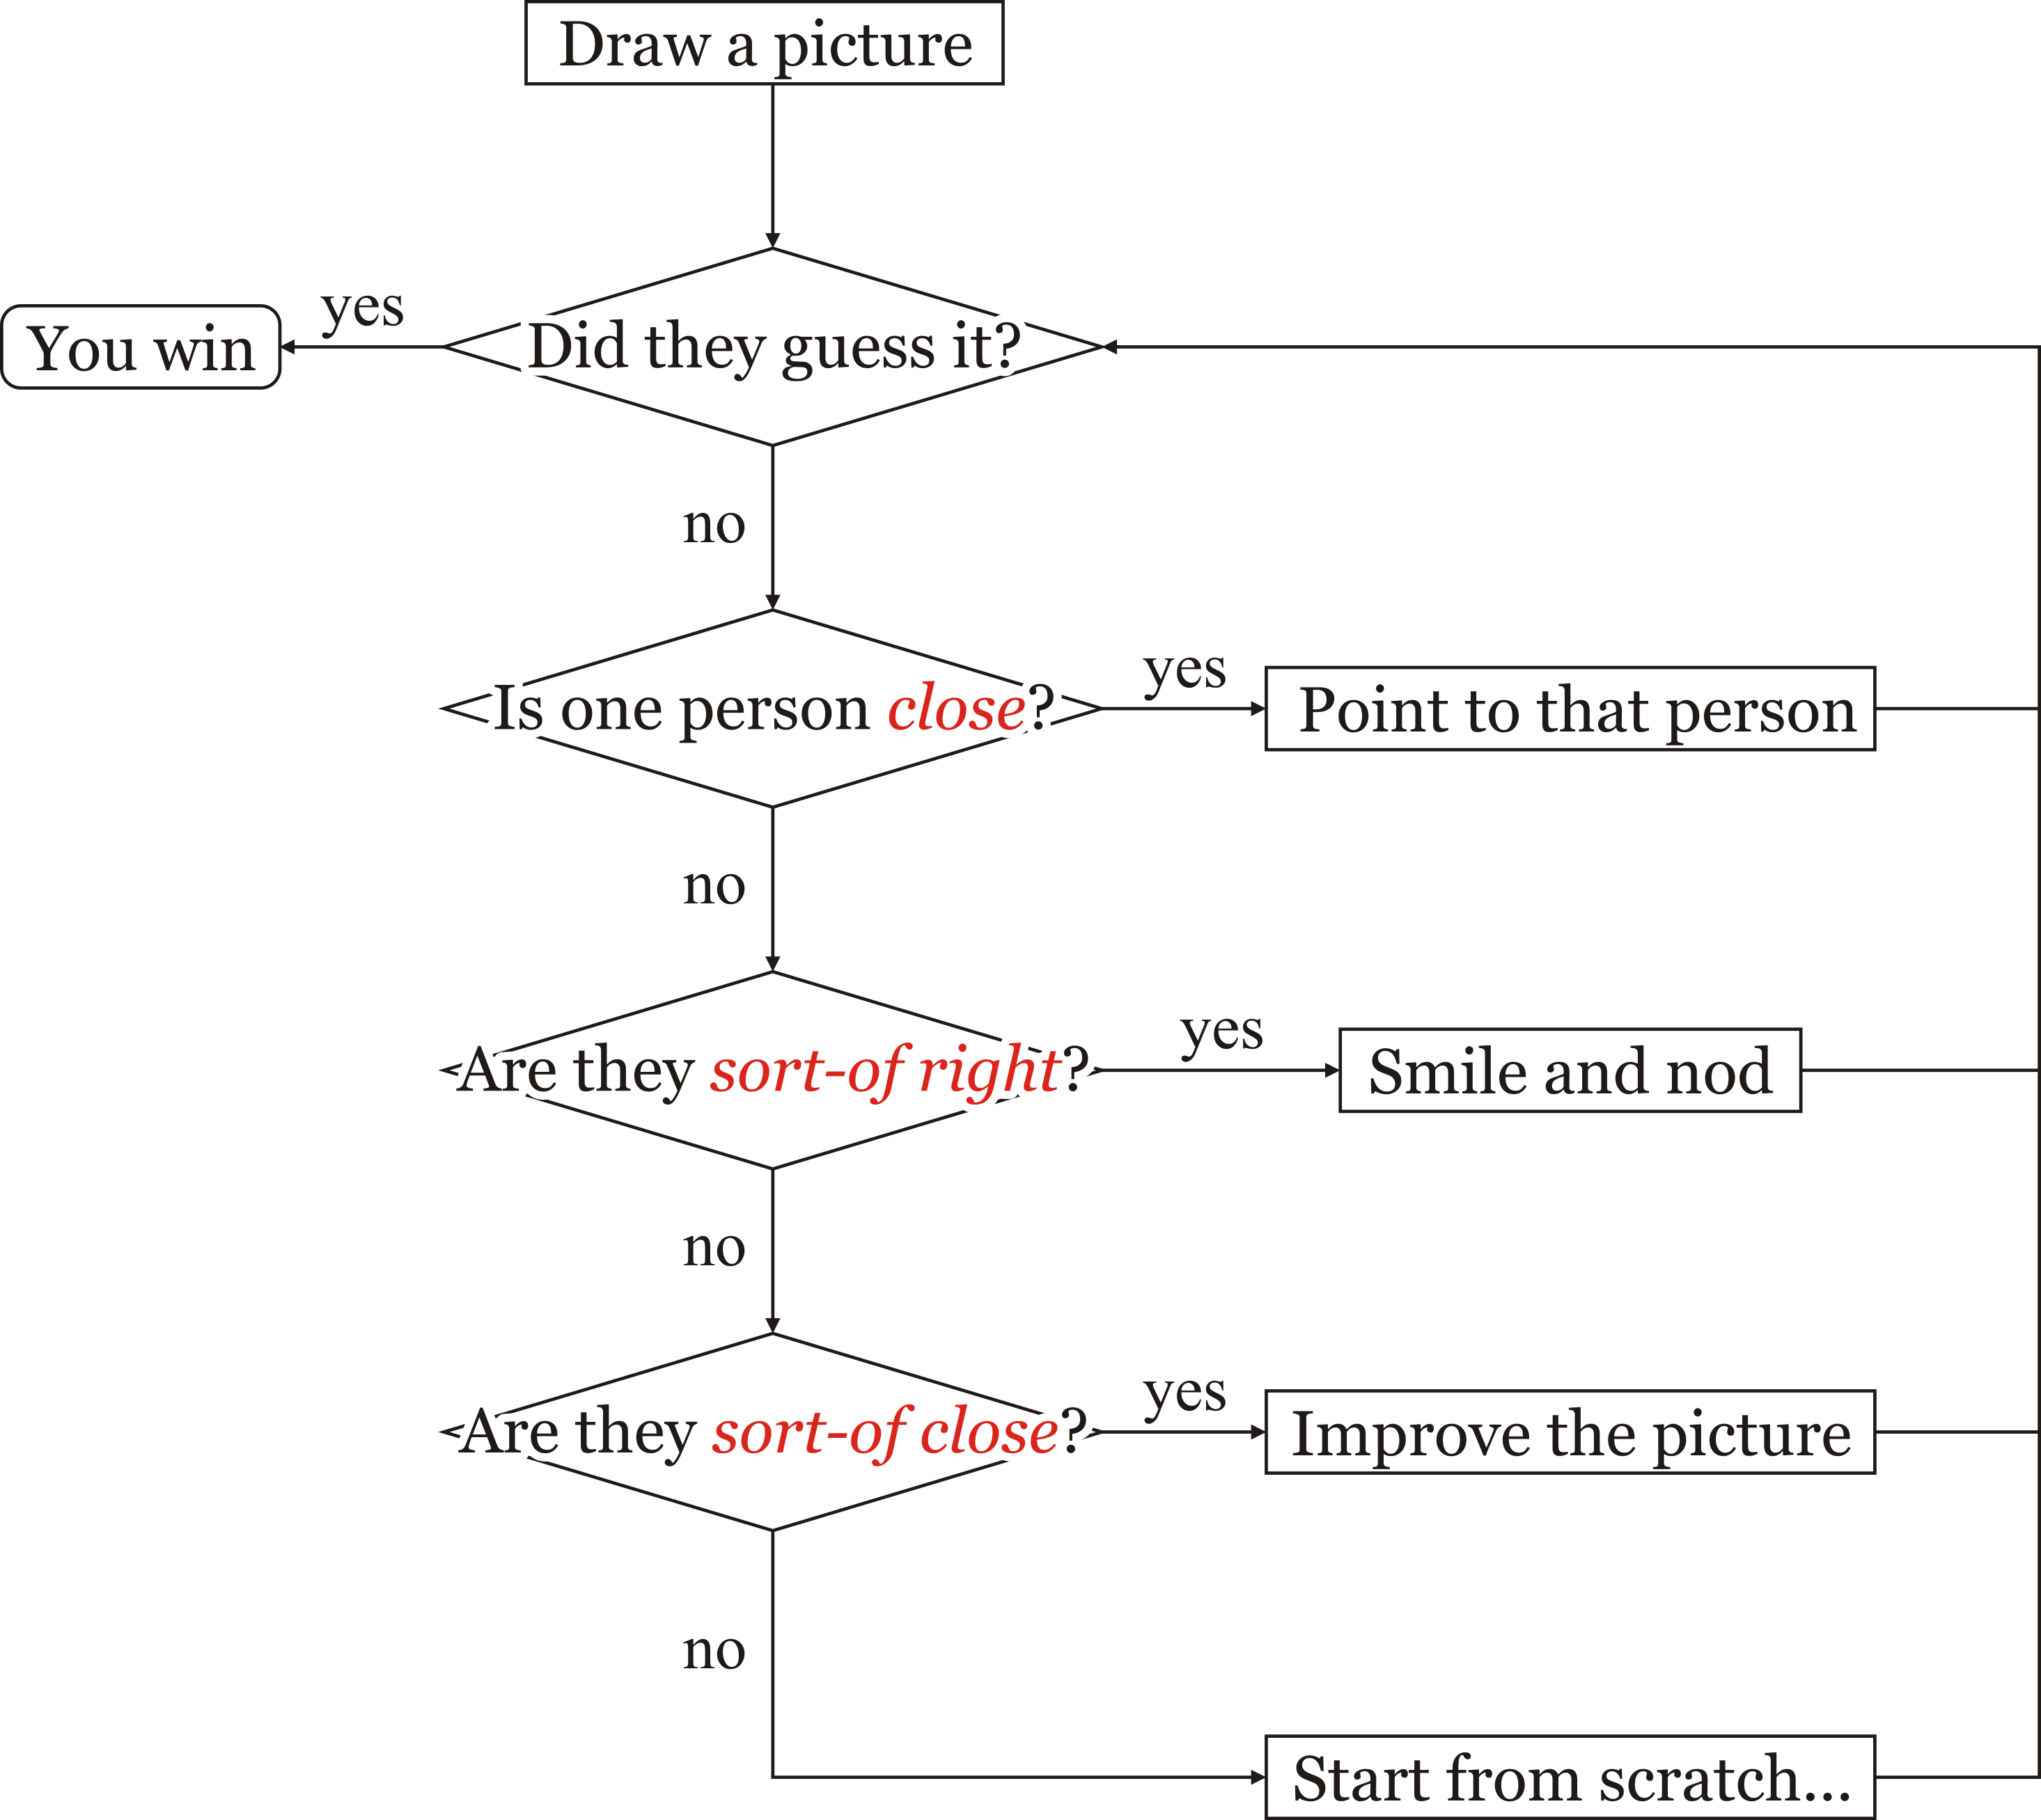
Repetitious operations
A more realistic version followed by many players
Each decision is not really objective
What is “close”?
What is “sort-of”?

Slide 6
Flow charts
A flow chart for simple repetition is to continue repeating a code block as long as some condition is true
As soon as the condition is false, we proceed to other statements

Slide 7
Flow charts
The repetitive behavior of this repetitive flow chart component leads to the name looping statement
We continue looping until a condition fails

Slide 8
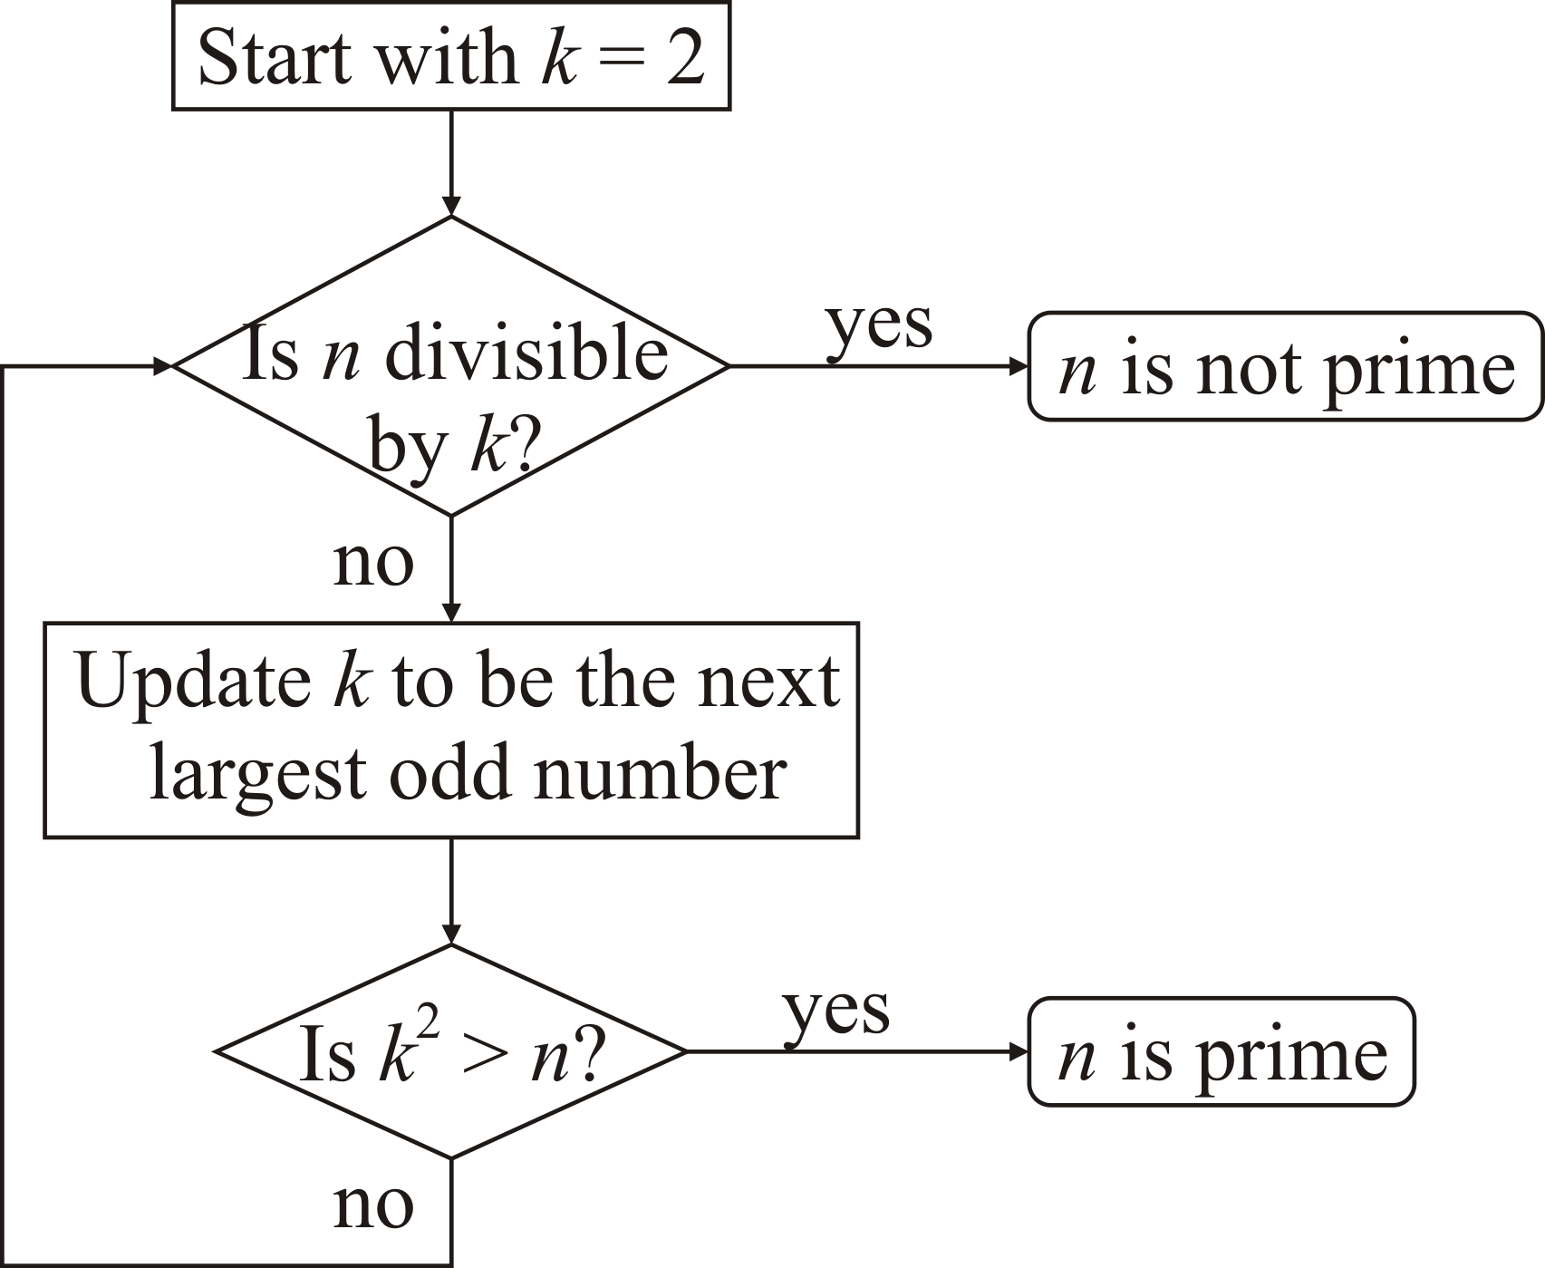
Repetitious operations
In mathematics, you learned a number of algorithms that depended on repetition:
To determine if n is prime:
Try dividing n by every integer k = 2, …, n – 1
If any remainder is zero, then n is not prime
Better yet, try dividing n by 2 and every odd number up to

Slide 9
Repetitious operations
Even long division is a repetitive algorithm:
Let m and n be real numbers both of which have a finite number of digits
Multiply both m and n by the smallest power of 10 that allows n to be an integer
In calculating m ÷ n, perform the following:
If |m| < 1, let the solution be the decimal point “.” and let r be the first digit after the decimal point
Otherwise, let r be the first non-zero digit of m and let the solution be “”
Now iterate:
Find the largest integer multiple d of n such that r – dn ≥ 0, append d to the solution and let r – dn be the new r
Add the next digit of m to the end of the new r and if the next digit is the first digit after the decimal place, place a decimal point at the end of the solution

Slide 10
Repetitious operations
In mathematics, you learned a number of algorithms that depended on repetition:
To calculate n!
You multiplied together all of the integers k = 2, …, n
To calculate , you find which requires three factorial calculations followed by one long division
You can reduce your work by calculating and then dividing by k!

Slide 11
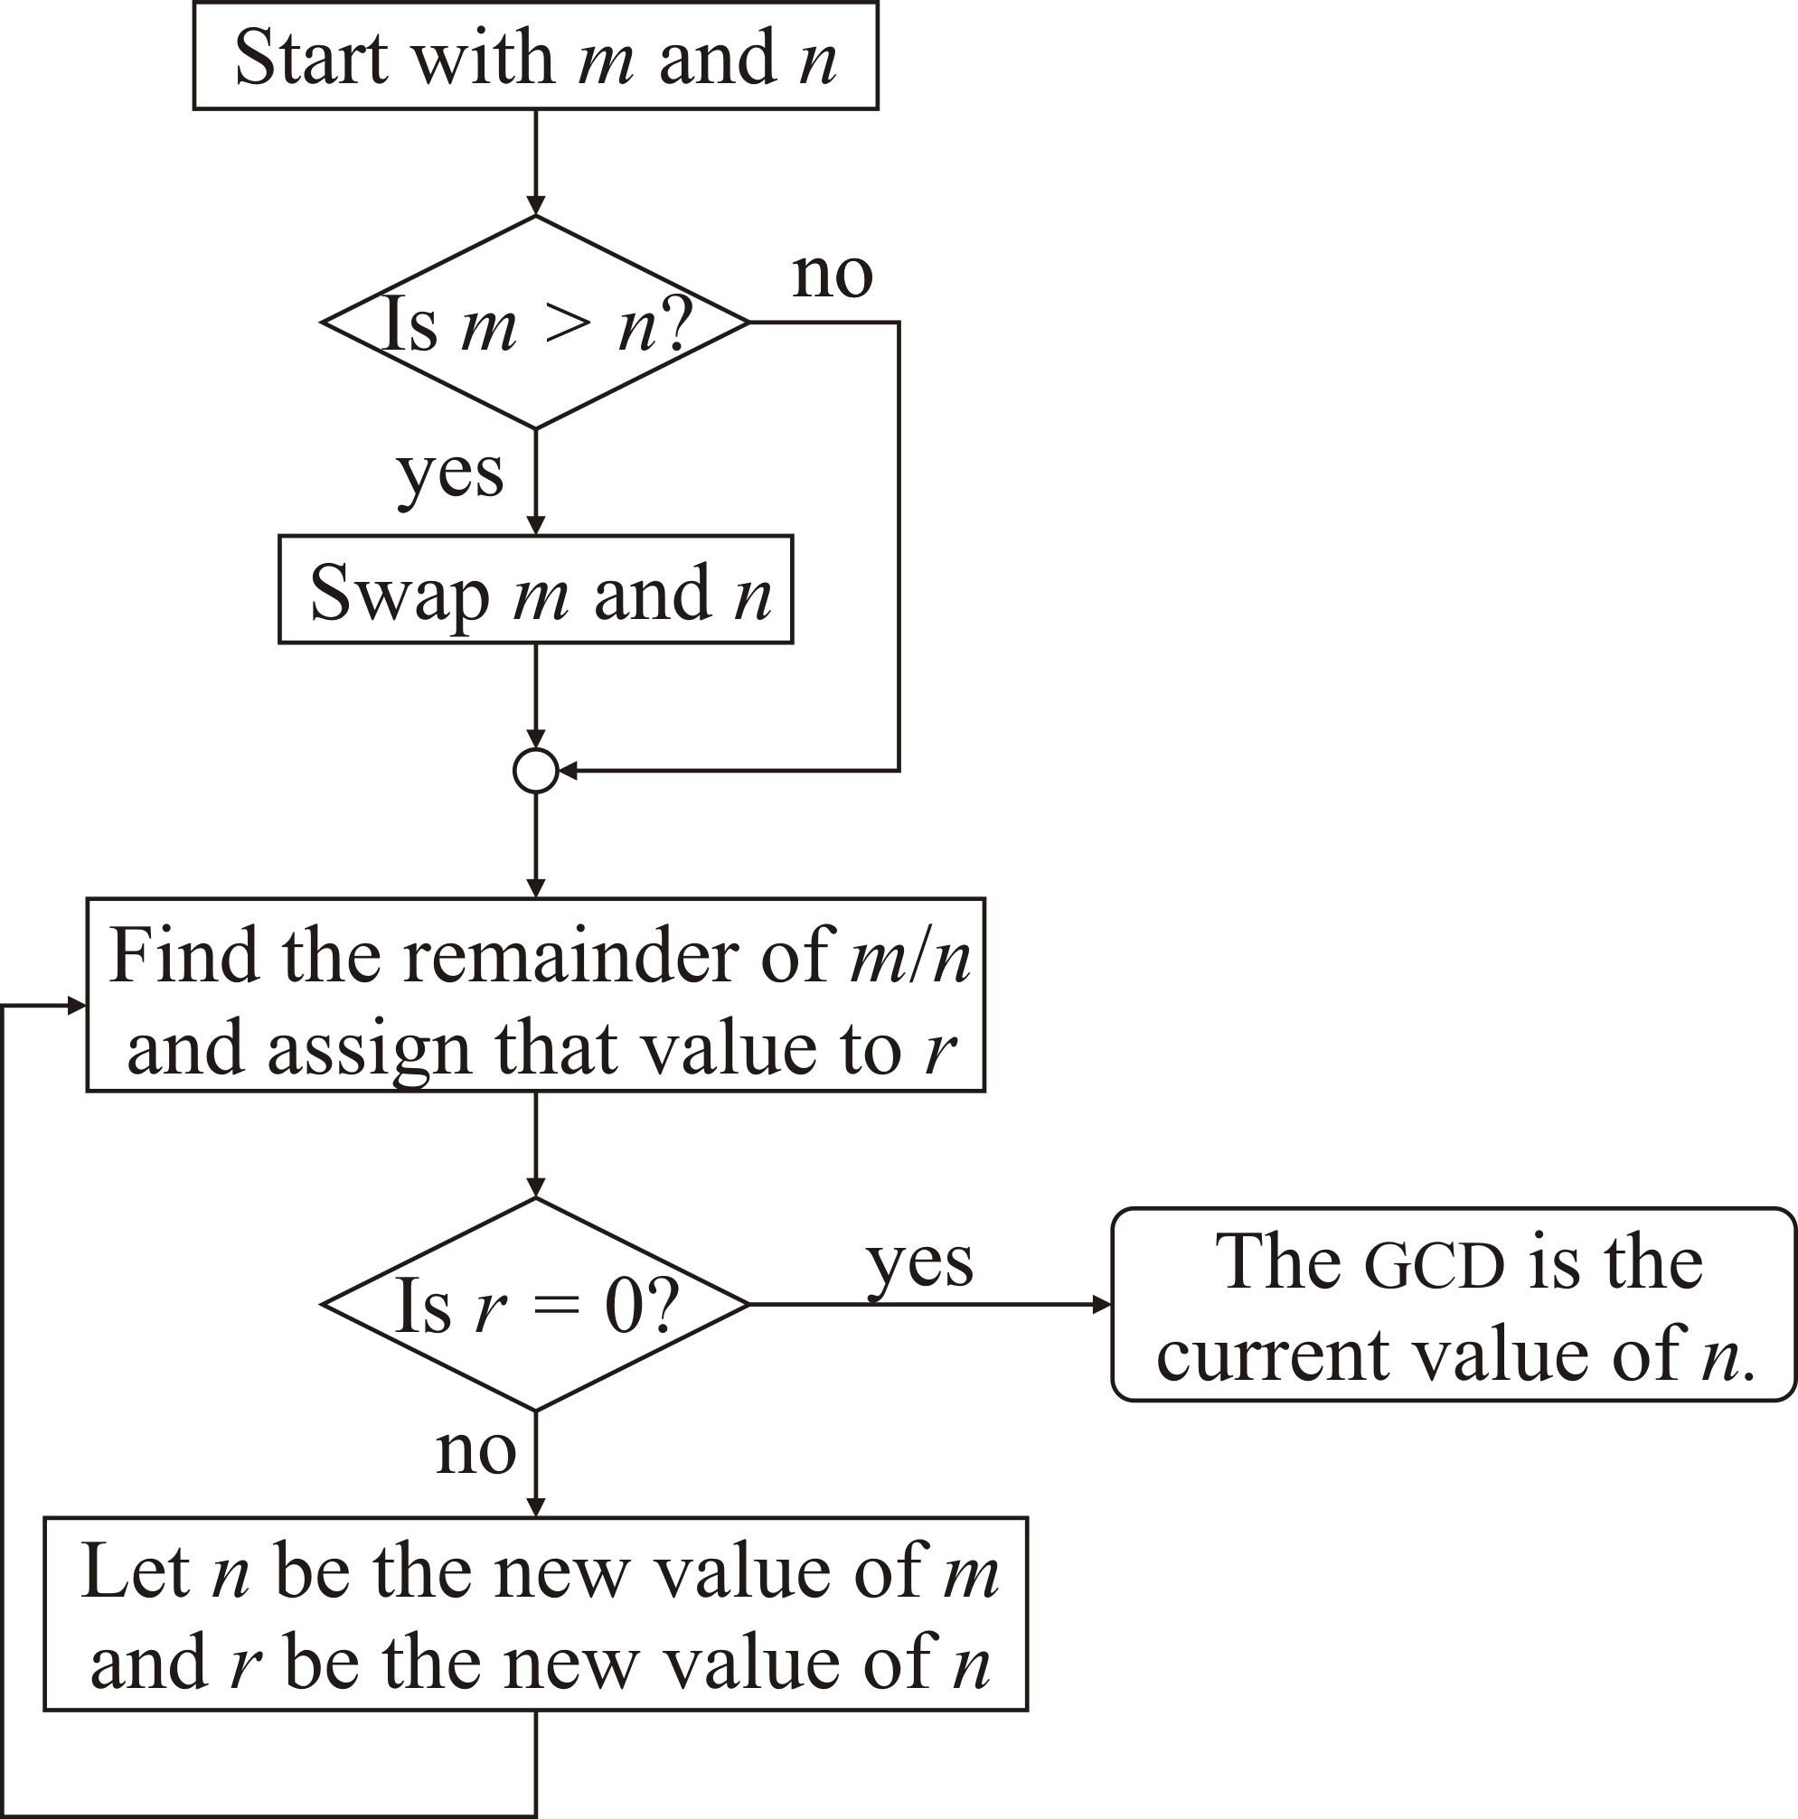
Repetitious operations
Each of these repetitious operations requires an exact number of steps to be performed
In some cases, you don’t know a priori when to stop
Consider finding the greatest common divisor (gcd) of 3094 and 19635:
19635 – 6 × 3094 = 1071
3095 – 2 × 1071 = 952
1071 – 1 × 952 = 119
952 – 8 × 119 = 0
The gcd is therefore 119

Slide 12
Repetitious operations
In programming languages, it is also necessary to repetitively perform a sequence of actions
In Pictionary, the choice of action was someone fuzzy
In mathematics, in each case the repetitive operation is well defined
In some cases, we know how often we will have to repeat an operation, in others, we may not know until we get a solution
That is, if a solution even exists
Like decision making, in programming languages we will have to reduce the decision as to how often to repeat down to a simple yes-no question

Slide 13
Summary
In this presentation, you now
Are familiar with repetitious operations
Have re-familiarized yourself with such operations in secondary school
Know the flow chart for such operations
Understand that the conditions for looping must be Boolean-valued
Either true or false

Slide 14
References
[1] Wikipedia
https://en.wikipedia.org/wiki/Pictionary

Slide 15
Acknowledgments
Proof read by Charlie Liu.

Slide 16



Colophon
These slides were prepared using the Georgia typeface. Mathematical equations use Times New Roman, and source code is presented using Consolas.
The photographs of lilacs in bloom appearing on the title slide and accenting the top of each other slide were taken at the Royal Botanical Gardens on May 27, 2018 by Douglas Wilhelm Harder. Please see
https://www.rbg.ca/
for more information.

Slide 17
Disclaimer
These slides are provided for the ece 150 Fundamentals of Programming course taught at the University of Waterloo. The material in it reflects the authors’ best judgment in light of the information available to them at the time of preparation. Any reliance on these course slides by any party for any other purpose are the responsibility of such parties. The authors accept no responsibility for damages, if any, suffered by any party as a result of decisions made or actions based on these course slides for any other purpose than that for which it was intended.

